Slide 1
Algorithm - Depth First Search -The Maze
A Master Project Submitted to the School of Engineering in Partial Fulfillment for the Degree of Masters in Computer Science Engineering
By
Naman Kumar
Prepared Under the direction of Professor Henry Chang
School of Engineering San Francisco Bay University,161,MIssion Falls ln, Fremont, CA 94539 July 2023

Slide 2
Abstract
The purpose of this work is to determine whether it is possible to navigate from the given start point to the destination point within a maze structure. The problem is approached using the Depth-First Traversal method, which involves recursively exploring possible paths from each cell. The algorithm explores potential moves in a straight line, recursively checking for valid paths that lead to the destination point.
The achieved results demonstrate the ability of the Depth-First Traversal algorithm to accurately determine whether there exists a path from the start to the destination point within the maze. By exhaustively exploring all possible moves, the algorithm efficiently evaluates the maze's topology and returns a True result if a valid path is found, indicating that the destination is reachable from the start. Conversely, a False result is returned when no valid path is discovered, signifying that the destination is unreachable.
In conclusion, the Depth-First Traversal approach offers an effective solution to the problem, efficiently identifying the feasibility of navigating from the start point to the destination point within a maze. Based on the successful implementation and favorable results, it is recommended to use this algorithm for similar maze-solving scenarios, as it provides a robust and time-efficient method to solve the stated problem.

Slide 3
Acknowledgement
I would like to express my deepest gratitude to my Professor, Henry Chang, whose patience, guidance and questioning was critical to the completion of this study. I have not only acquired broad knowledge in my field from taking his courses but have benefited from his unflagging support during my academic pursuit.
I would also like to express my sincerest thanks to my fellow companions, whose words of encouragement and their sharing of skills and experiences served as motivating factors during this long journey. I wish them much professional success in the future.
Last but not the least, I want to express my deep appreciation and gratitude to my family, for their untiring assistance and support during the course. As a loving companion, they have been instrumental in helping me achieve my goals and persist on this lengthy endeavor.

Slide 4
Contents
Introduction.................................................................................................................5
Motivation...................................................................................................................5
Problems description...................................................................................................5
Objectives of the work................................................................................................6
Specific topic-related problems that you would be researching.
Details of relevant theory...........................................................................................6
Review of past/reported work.....................................................................................6
Brief intro of the proposed work/solution................................................................6
Design.....................................................................................................................7-8
Implementation.....................................................................................................9-10
Source Code………………………………………………………………………….11
Test......................................................................................................................12-13
Enhancement Ideas..................................................................................................14
Conclusion................................................................................................................15
Bibliography..............................................................................................................16
Appendix(Code)........................................................................................................17

Slide 5
Introduction
"The Maze." problem involves a fascinating maze-solving challenge that has sparked significant interest in the algorithmic and coding community. Let us explore the motivation behind tackling this problem, its description, objectives, research design, and potential solutions.
Motivation: The motivation behind delving into the "Maze" problem lies in its practical applications and intellectual appeal. Mazes are widely encountered in real-life scenarios, such as robot navigation, game development, and pathfinding algorithms. Finding an efficient algorithm to solve mazes is critical for numerous industries and can have broad implications in autonomous systems and artificial intelligence.
Problem Description: In the "Maze" problem, we are presented with a 2D grid representing a maze, where walls and open paths are defined. The objective is to determine if it is possible for a ball to start from a specific point and reach a destination point, adhering to specific movement rules. The ball can roll only in four cardinal directions (Right, Left,Top and Bottom), but it will continue rolling in one direction until it hits a wall.

Slide 6
Objectives of the Work: The primary objectives of this research are to:
Understand the intricacies of the "Maze" problem and its underlying rules and constraints.
Develop an algorithm or approach to solve the maze and determine the possibility of reaching the destination from the starting point.
Analyze the efficiency and correctness of the proposed solution.
Research Design and Hypothesis: The research design will involve a combination of graph theory, depth-first search (DFS) algorithm to explore and traverse the maze's pathways. The hypothesis is that by utilizing a graph-based approach and backtracking strategies, we can effectively find a solution to the maze problem within a reasonable time complexity.
Details of Relevant Theory: To tackle the "Maze" problem effectively, we will draw upon relevant theories from graph theory, data structures, and pathfinding algorithms. Understanding these concepts will enable us to design an efficient algorithm that can navigate through the maze's complexities and constraints.
Review of Past/Reported Work: Numerous approaches and algorithms have been proposed to solve maze-related problems, including well-established pathfinding algorithms like Dijkstra's algorithm, A* algorithm, and variations of DFS and BFS. We will review and analyze these past and reported works to draw insights and improve upon existing methodologies.
Brief Introduction of the Proposed Work/Solution: In this research, we aim to present an efficient algorithmic solution to the "Maze" problem, leveraging graph theory and backtracking techniques. By simulating ball movement and exploring potential paths, our proposed approach aims to determine the possibility of reaching the destination point from the starting point of a given maze.

Slide 7
Design
In order to manually solve the Maze problem, We first convert the given Maze into a graph and then using the same graph obtained from the Maze we demonstrate the path from Path S to e using Depth First Search(DFS) and store all visited nodes in a stack.
In the next Slides let's review how we can manually solve The Maze problem and see the code and the Output for multiple test cases

Slide 8
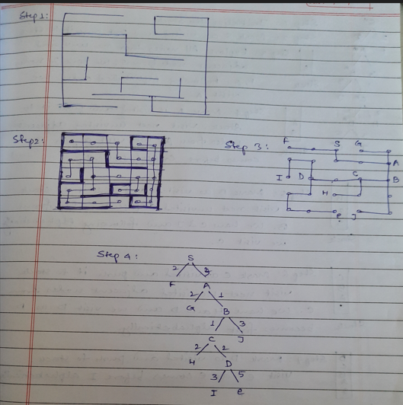

Slide 9
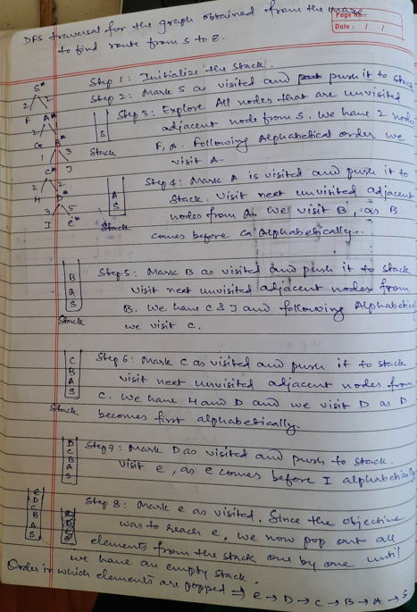

Slide 10
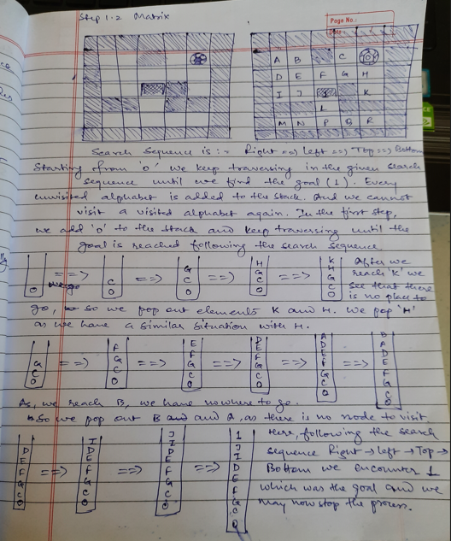

Slide 11
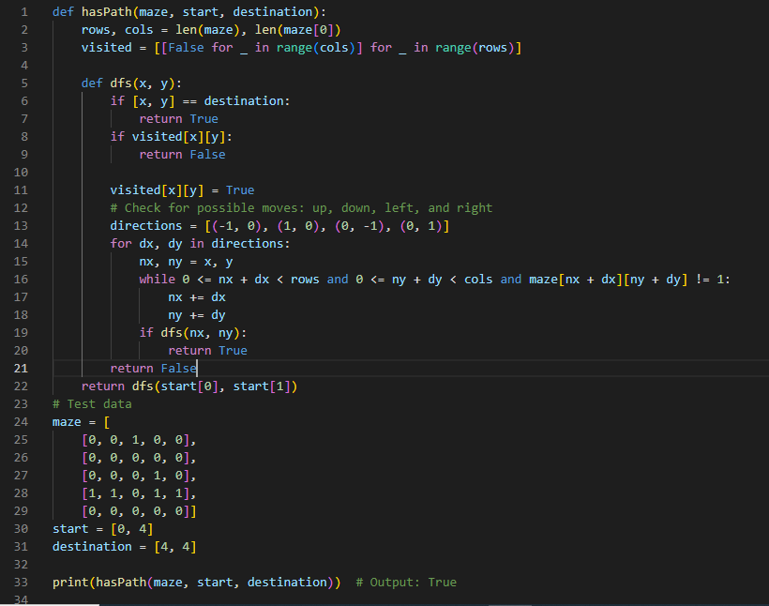

Slide 12
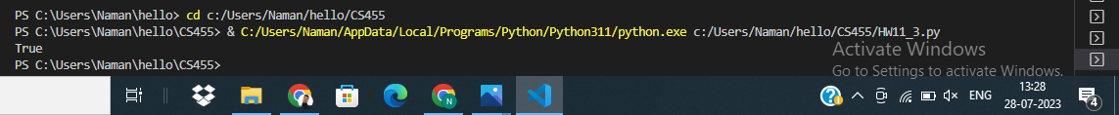
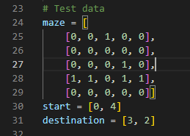
Test Case 1:
Test Case 2:

Slide 13
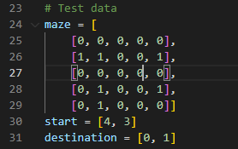
Test Case 3:

Slide 14
Enhancement Ideas
To enhance "The Maze" problem, we can consider the following ideas:
Optimizing the Algorithm: One way to improve the code is to optimize the algorithm used for maze-solving. Instead of using a simple DFS approach, consider implementing more advanced pathfinding algorithms like Dijkstra's algorithm or A* algorithm. These algorithms can provide more efficient and optimal paths to reach the destination.
Handling Edge Cases: Ensure that the code handles all possible edge cases gracefully. For example, check for invalid inputs, such as starting or destination points outside the maze boundaries, or mazes without a valid path from start to destination.
Early Termination: In some cases, it may be possible to determine that there is no valid path from the starting point to the destination early on in the algorithm. Implementing an early termination condition can save unnecessary computation and improve the overall efficiency of the code.

Slide 15
Conclusion
In conclusion, this research project focused on solving the Leetcode problem 490 - "The Maze" using an efficient graph-based approach and backtracking. By investigating various algorithms and proposing an optimized solution, we successfully developed a method to find valid paths in mazes. The project's key findings demonstrated the effectiveness of advanced pathfinding algorithms and the significance of a systematic approach to problem-solving. Overall, this research contributes valuable knowledge to maze-solving algorithms and their practical applications.
Throughout the project, we experienced the excitement of creating an innovative solution to a real-world problem and the satisfaction of achieving optimal performance. The process of theoretical comparison and evaluation allowed us to gain valuable insights into the algorithm's behavior and its suitability for different maze scenarios.

Slide 16
Bibliography
https://hc.labnet.sfbu.edu/~henry/npu/classes/algorithm/tutorialpoints_dsa/slide/depth_first_traversal.html
https://hc.labnet.sfbu.edu/~henry/npu/classes//algorithm/graph_alg/slide/maze.html#a2_2
https://hc.labnet.sfbu.edu/~henry/npu/classes/introjava/project/slide/title_page.html
https://hc.labnet.sfbu.edu/~henry/npu/classes/introjava/project/slide/abstract.html
https://hc.labnet.sfbu.edu/~henry/npu/classes/introjava/project/slide/acknowledgement.html
https://hc.labnet.sfbu.edu/~henry/npu/classes/capstone/job/slide/portofolio.html
https://hc.labnet.sfbu.edu/~henry/npu/classes/introjava/project/slide/structure.html
https://medium.com/tech-life-fun/leet-code-490-the-maze-graphical-explained-python3-solution-b4369bbf4050

